Slide 1



IOT Project: Smart Attendance System Using ESP32 and Fingerprint Sensor
Prepared By:
Ahmed Farghaly Khalaf Abdelhalim Mohammed Ibrahem
Enas Ibrahem Ali Amr Abdelbaky Mohammed
Salma Amer Ahmed Abdelrahman Mohammed Farghal
Malak Tamer Mohammed Abdelrahman Esam Fathy
Fatma Mohammed Helmy
Under Supervision of
Dr. Enas Elgeldaiwi
Dr. Sohair Kilany
Eng. Salman Mohammed

Slide 2
Smart Attendance System
The Problem Statement
Traditional attendance systems are time-consuming
High risk of fraud and proxy attendance
Difficult to track attendance in real-time
02

Slide 3
Smart Attendance System
Idea / Solution
Smart attendance system based on fingerprint recognition
Each student uses a unique fingerprint
Attendance is recorded automtically in the system
02

Slide 4
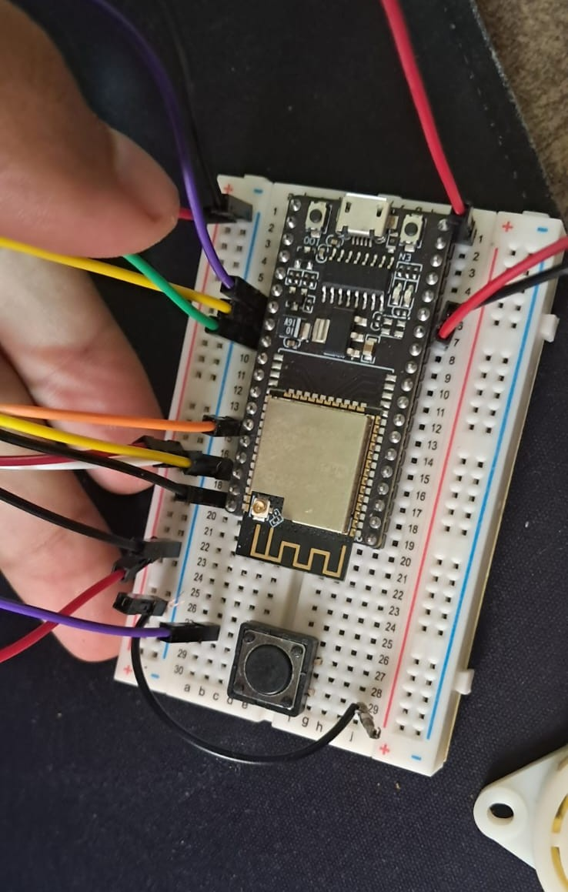
Smart Attendance System
Project Architecture
Hardware Overview
Our system integrates the following components:
Microcontroller: ESP32 (Handles WiFi and Logic).
Biometrics: Adafruit Fingerprint Sensor (Optical scanning).
Display: LCD 16x2 with I2C (User interface).
Cloud Integration: Google Apps Script (Web App URL).
Feedback: Active Buzzer for different sound alerts.
03

Slide 5
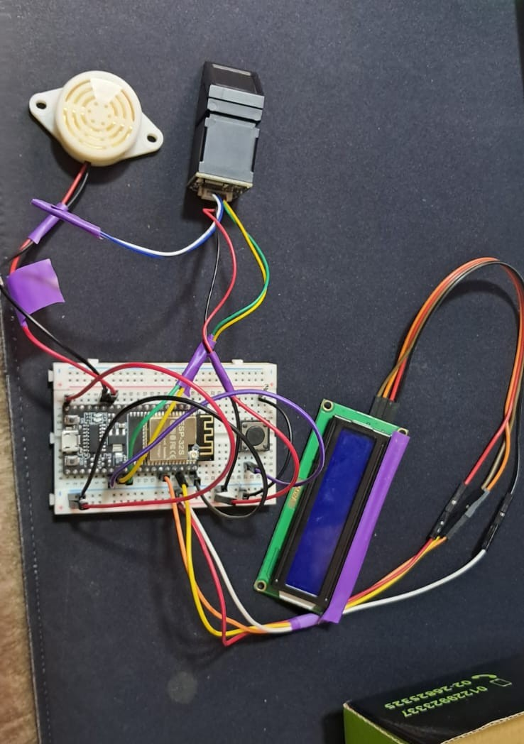
Smart Attendance System
Components Used
1. ESP32 Microcontroller
2. Fingerprint Sensor
3. Wi-Fi connection
4. Database (Sheets)
5. Power supply
04

Slide 6
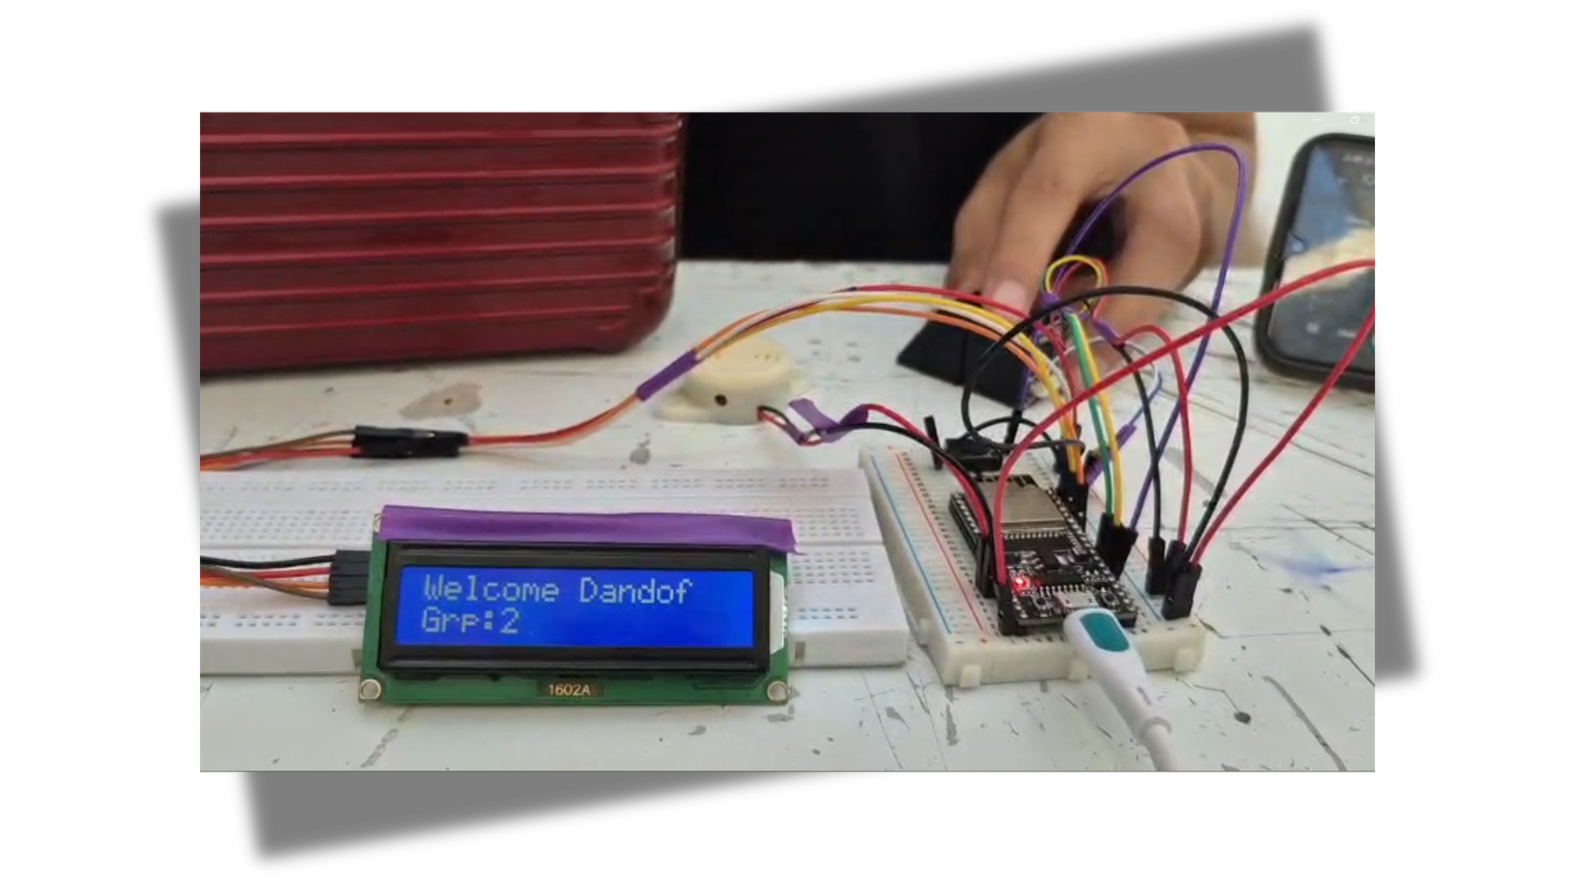
Smart Attendance System
How It Work (Flow)
User places fingerprint on the sensor
Sensor reads fingerprint data
ESP32 verifies the fingerprint
If valid → attendance is recorded
Data is sent to the datbase via Wi-Fi
04

Slide 7
System Architecture
Fingerprint Scan → ESP32 → Verification → Attendance Recorded → Sent to Sheets
05

Slide 8
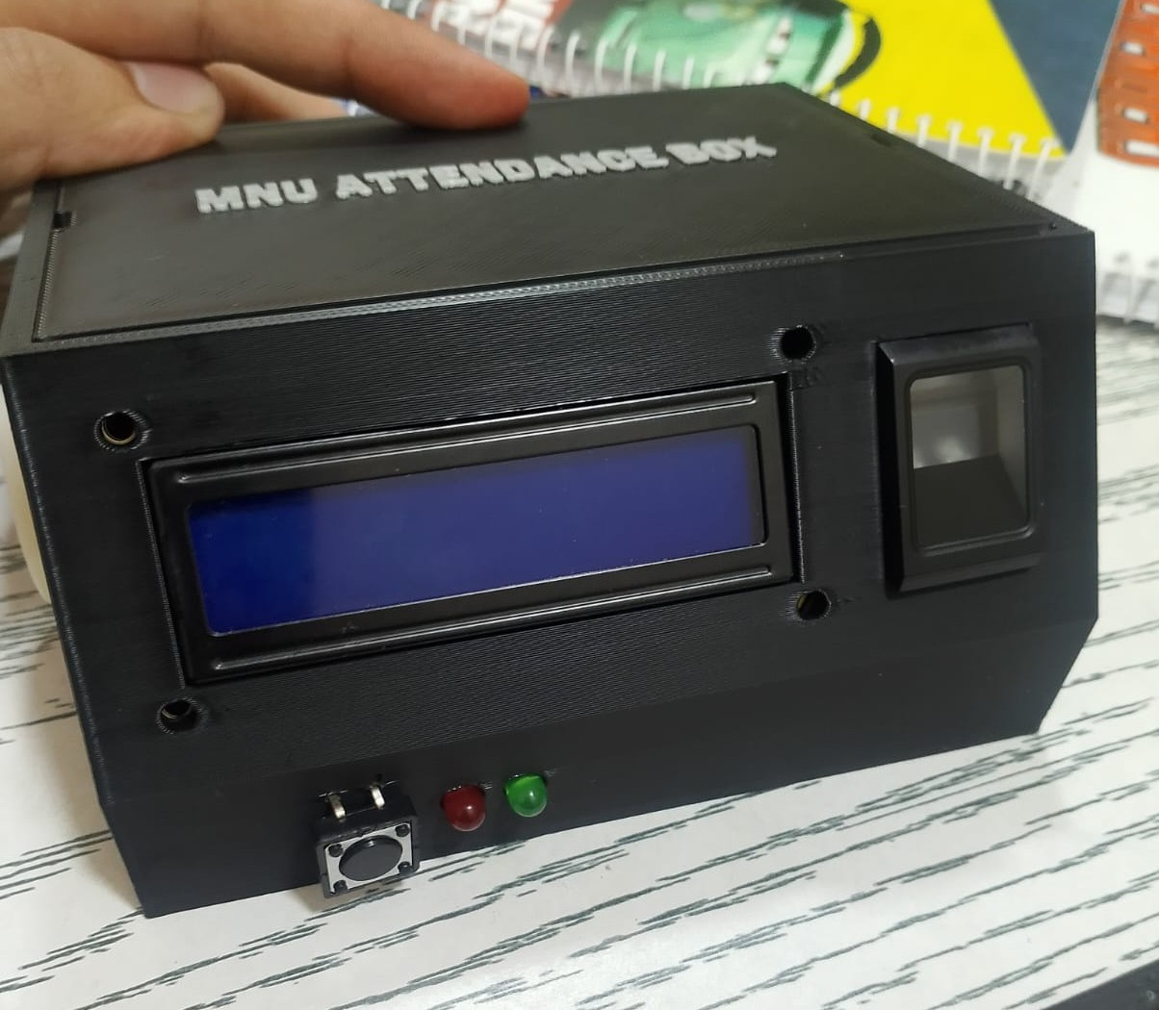
Smart Attendance System
Benefits & Key Features
1. Fast attendance recording
2. Prevents cheating and impersonation
3. Real-time tracking
4. Easy user management (add/remove users)
11

Slide 9
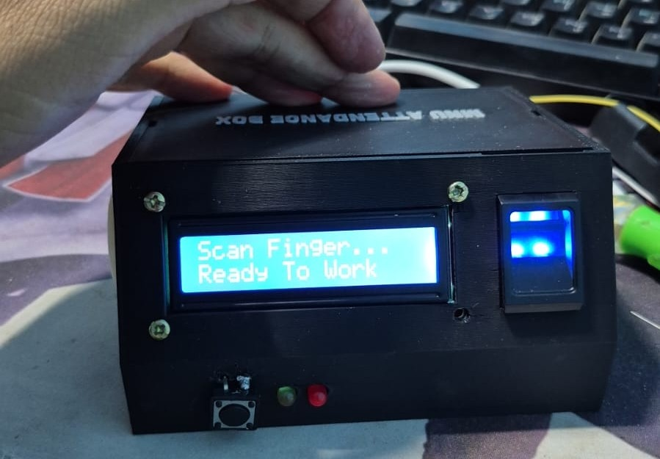
Smart Attendance System
Conclusion
1. The system improves traditional attendance methods
2. Uses IoT and biometric technology
3. Scalable for schools, universities, and companies
Link Drive:
https://drive.google.com/drive/folders/1pe-SdsFcskn32sEsonugbhUYkAukHsvc?usp=sharing
11

Slide 10
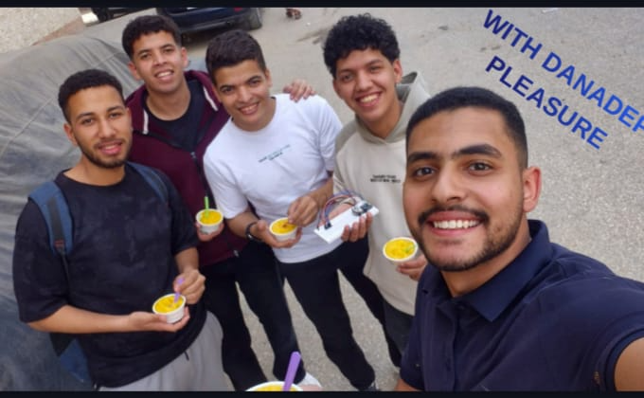

Slide 11
Questions?
THANK YOU
Smart Attendance System

